Slide 1

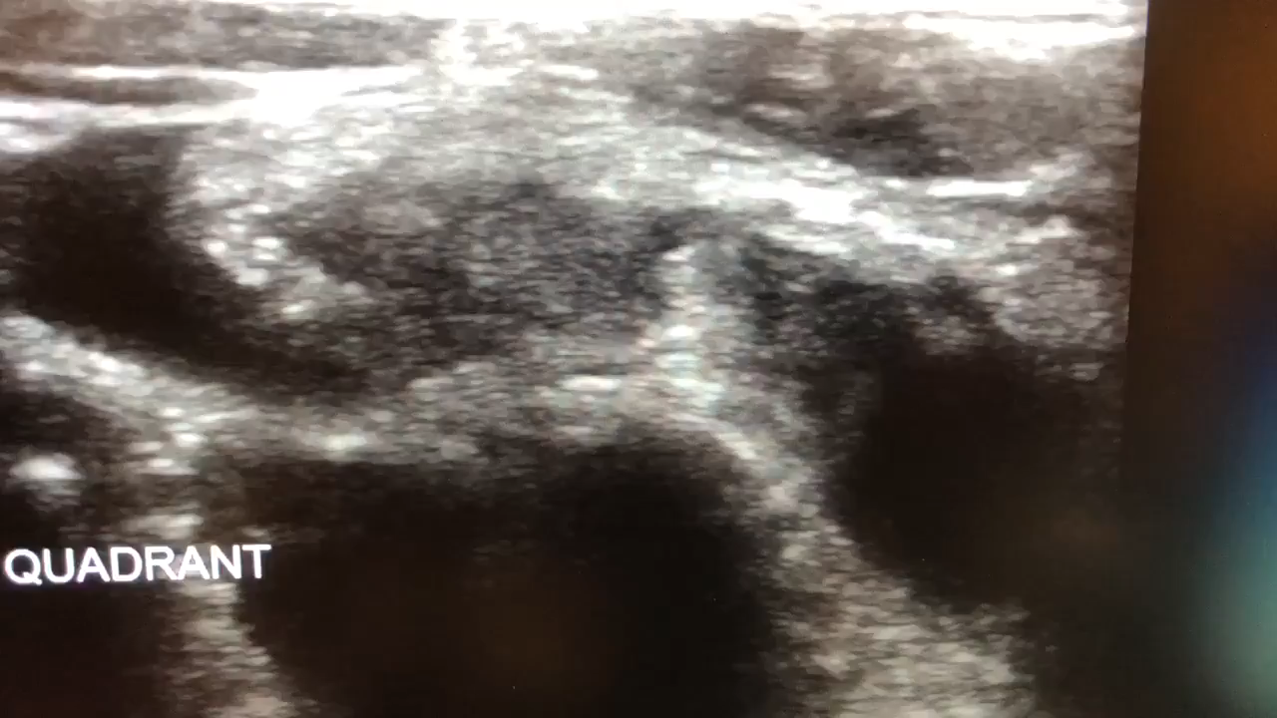
Appendicitis Point of Care Ultrasound

Slide 2
Outline
Indications and relative contraindications
Appendix anatomy including anatomical variants
Patient positioning and scanning technique
Clinical integration

Slide 3
The right patient for RLQ POCUS
Clinical concern for appendicitis (RLQ pain, fever, anorexia, nausea, vomiting)
Pain is controlled
Immediate surgery is not a better option

Slide 4
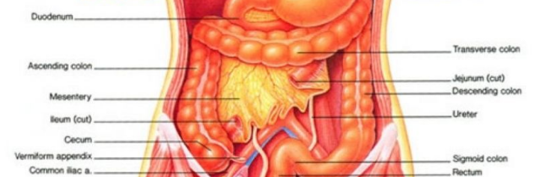
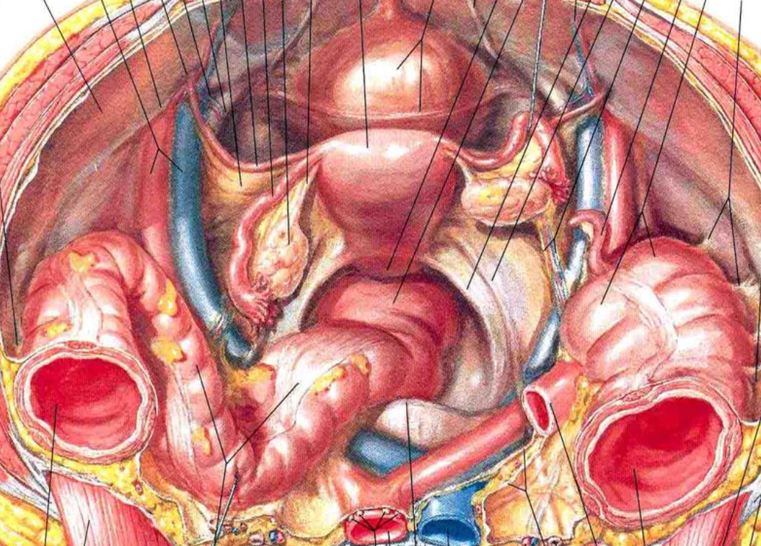
Appendix Anatomy
The appendix is located in the RLQ
Commonly found overlying the iliac artery/vein

Slide 5
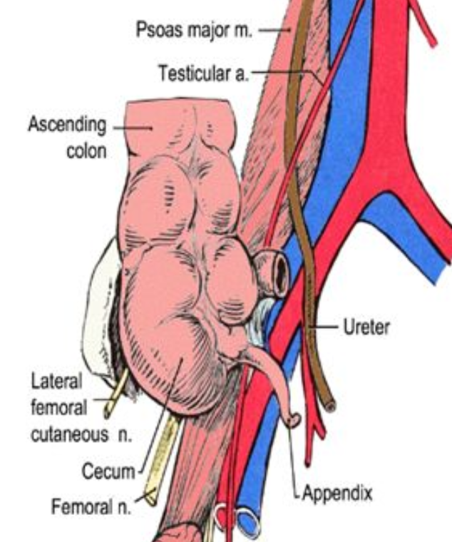
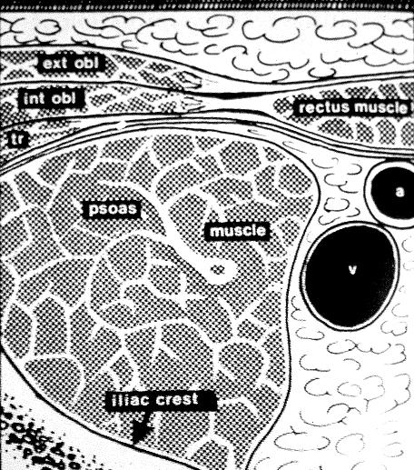
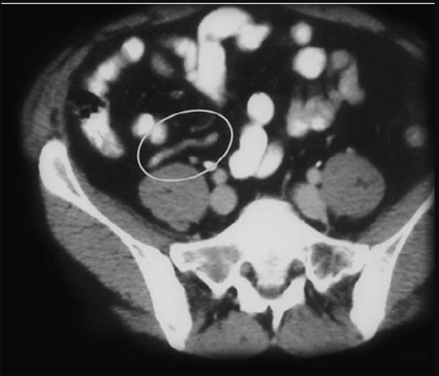
Appendix Anatomy
The appendix is located in the RLQ
Commonly found overlying the iliac artery/vein AND psoas muscle

Slide 6
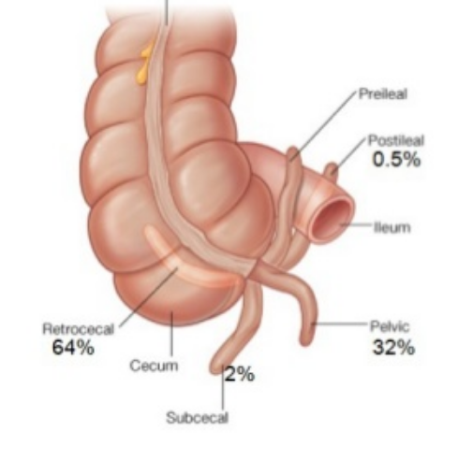
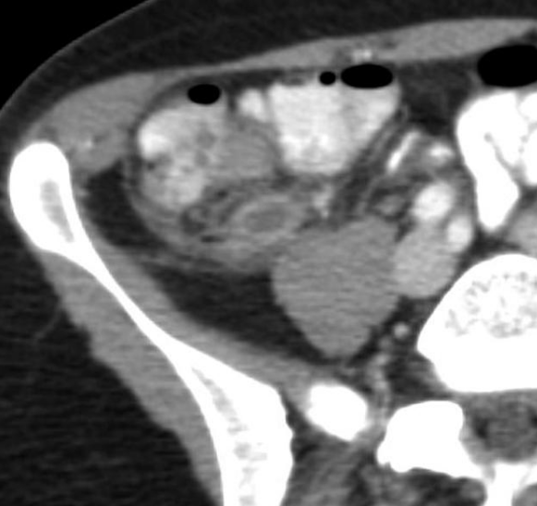
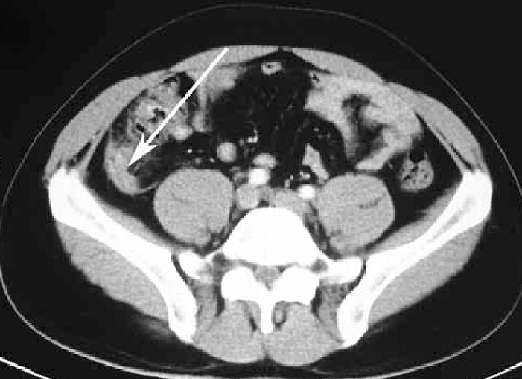
Appendix Anatomy Variants…
The appendix is actually only above the iliacs about 1/3 of the time
More likely, it is found behind the cecum, where there less well defined landmarks

Slide 7
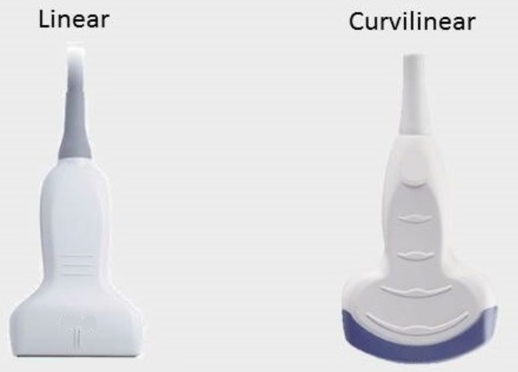
Probe Selection
Linear is good for image quality
Curvilinear is good for tissue penetration

Slide 8
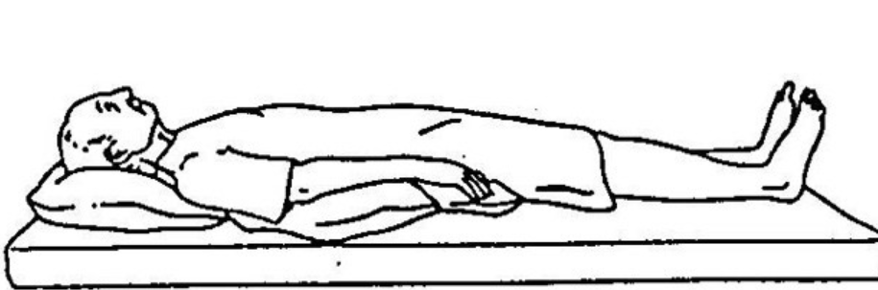
Patient Positioning
Scanning is done in the supine position
If tolerable, crossing the patient’s right leg over the left may help bring appendix more anterior

Slide 9
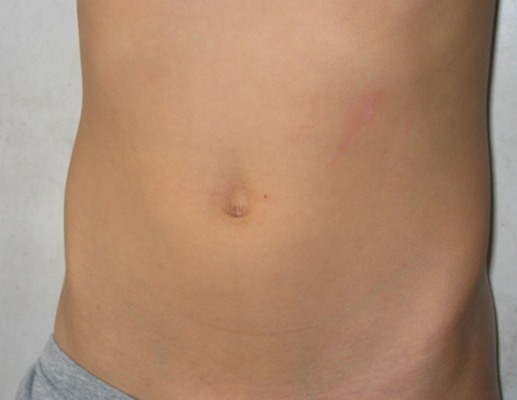
Scanning technique: point of most pain
Have the patient point to the location of most intense pain and put the probe there
Transverse view -> indicator to patient’s right
Sagittal -> indicator to patient’s head

Slide 10
Scanning technique: systematic
Search systematically for the appendix or landmark
Keep the indicator up or to the right

Slide 11
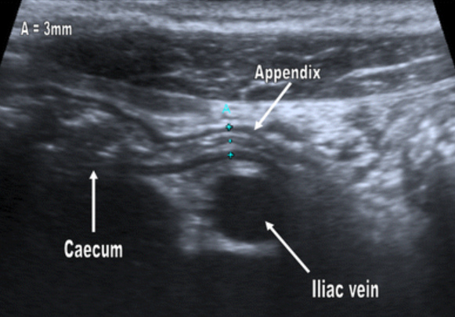
Ultrasound findings in normal appendix
Tubular structure (<6 mm diameter)
Compressible
Non-peristaltic
Proximal portion enters the cecum

Slide 12
Ultrasound findings in normal appendix
VS Small bowel
Peristalsing with luminal contents
VS Large bowel (cecum)
Large stx with “dirty air pattern”

Slide 13
Ultrasound signs of acute appendicitis
Direct Signs
Non-compressibility
Diameter >6 mm
Appendicolith – hyperechoic with posterior shadowing
Target sign
Hypoechoic fluid
Hyperechoic mucosa/submucosa
Hypoechoic muscularis
Hyper vascularity on color doppler
Indirect Signs
Free fluid surrounding appendix
Abscess formation
Hyperechoic local mesenteric fat

Slide 14
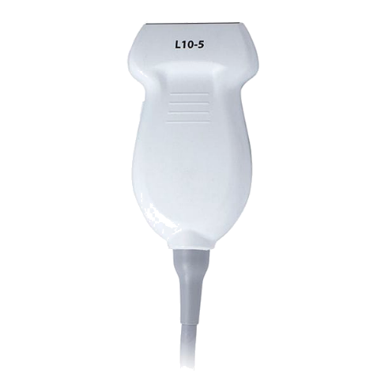
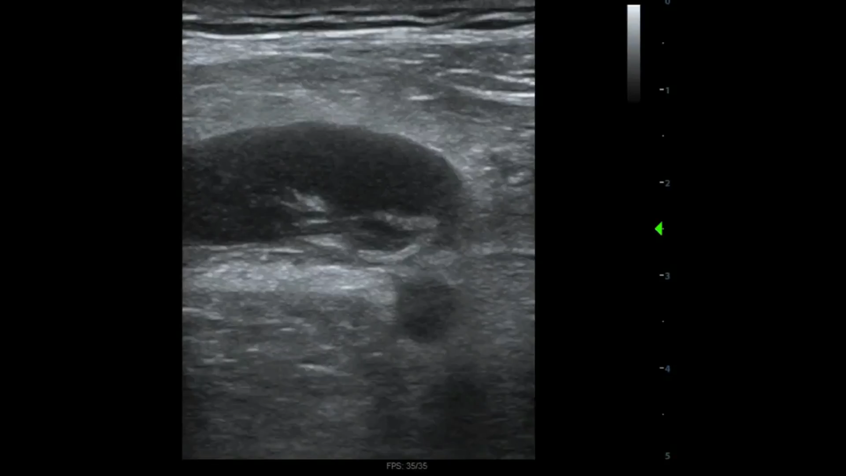
Findings
Free fluid

Slide 15

Objectives
Indications for Appendix POCUS
Transducer Selection
RLQ Anatomy
Ultrasound findings in appendicitis

Slide 16


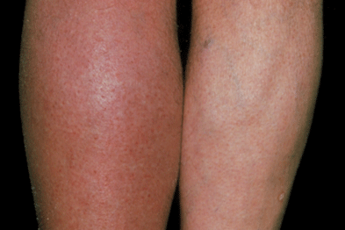
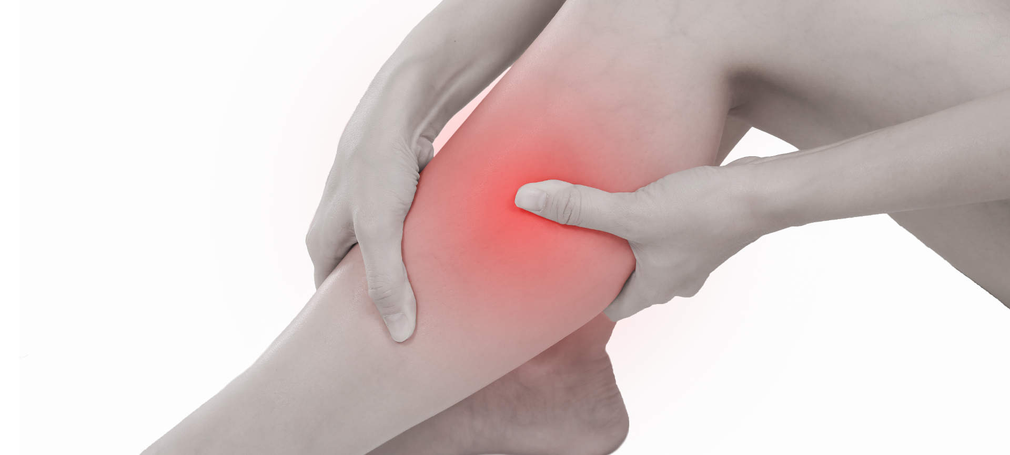
Indications for DVT POCUS
Leg Pain
Leg Swelling
Erythema
Chest Pain/SOB

Slide 17
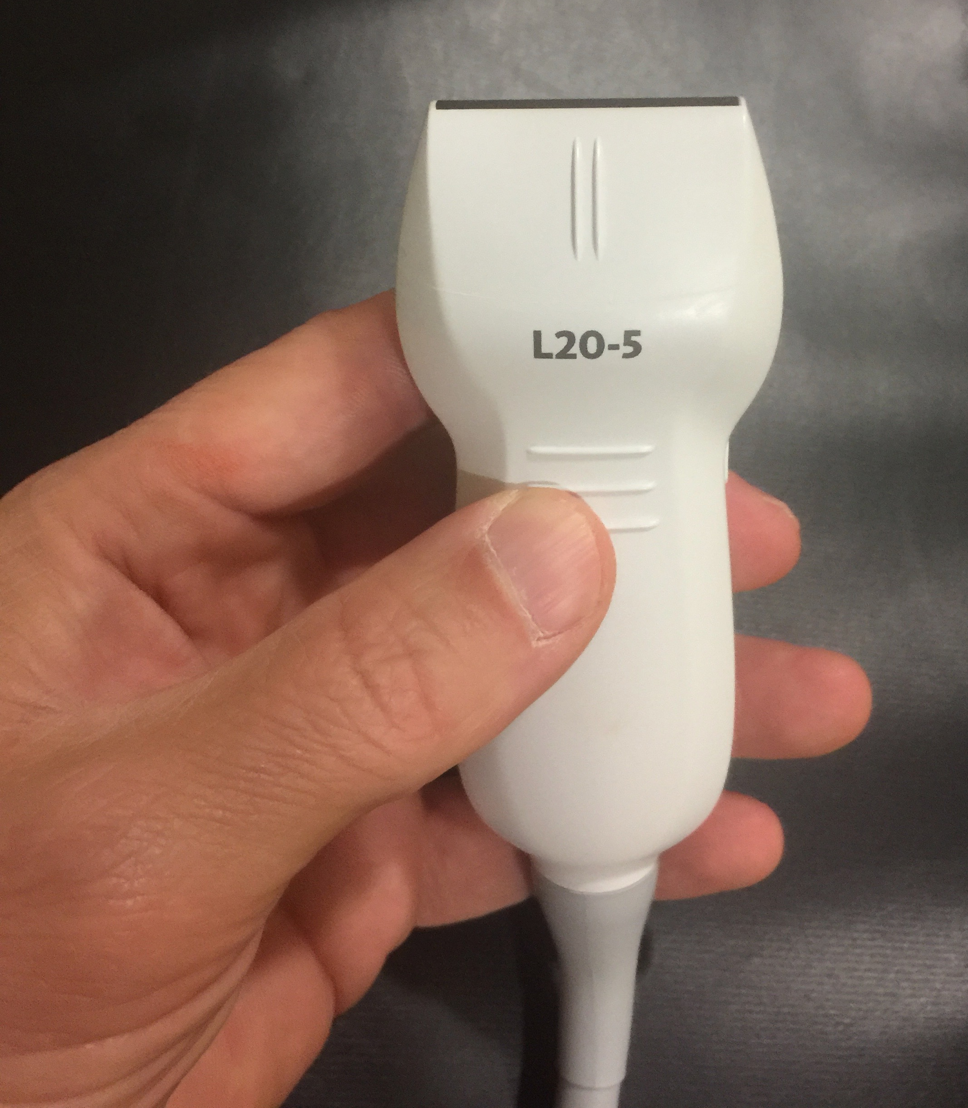
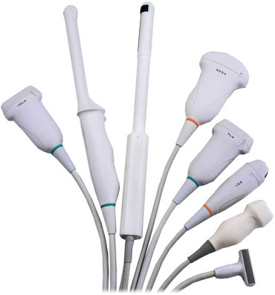
Transducer Selection

Slide 18
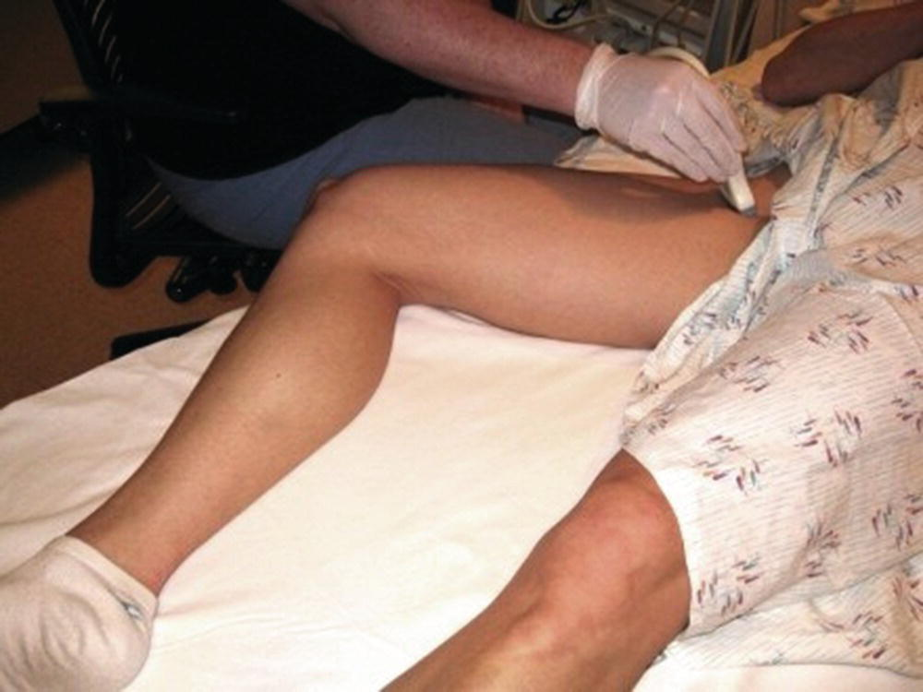
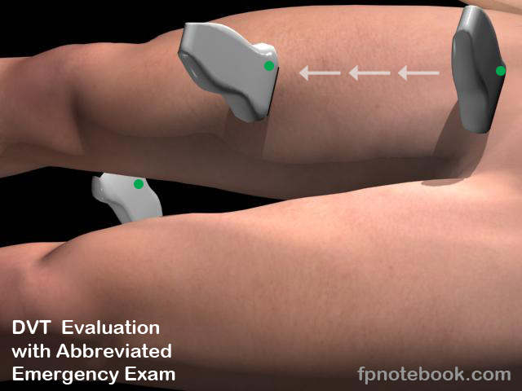
Patient Positioning for DVT POCUS

Slide 19
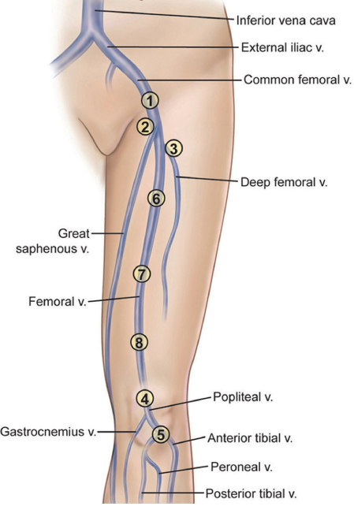
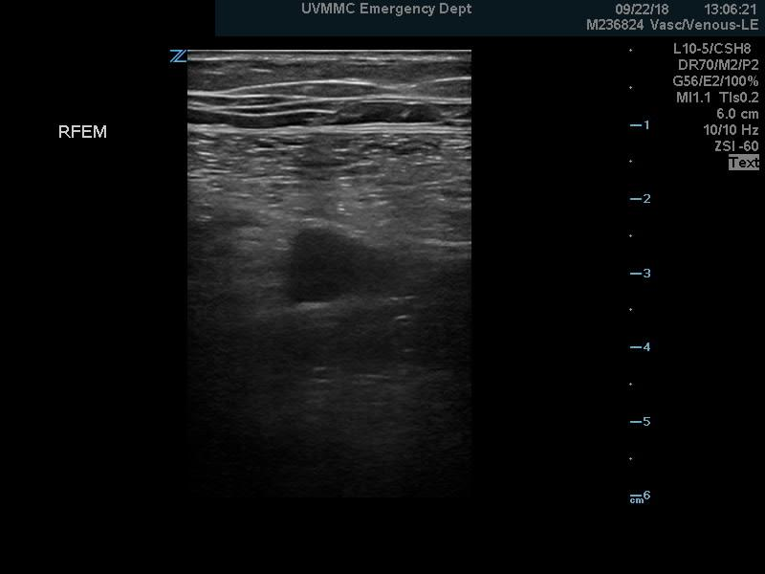
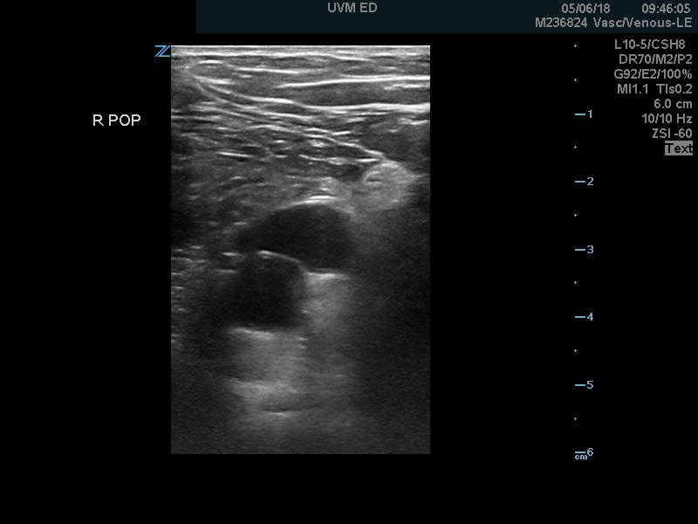
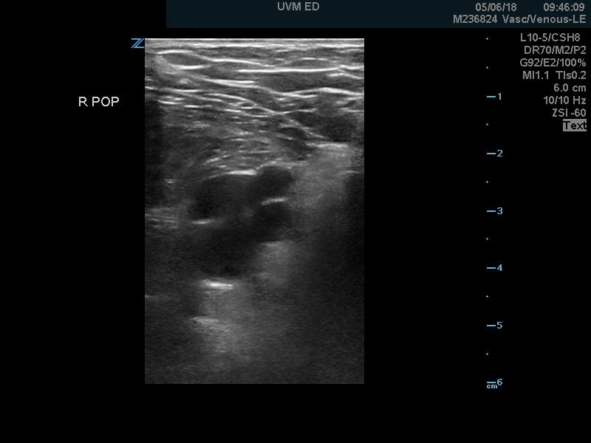
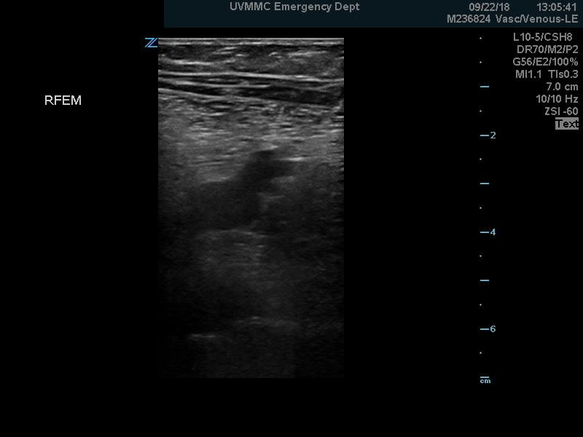
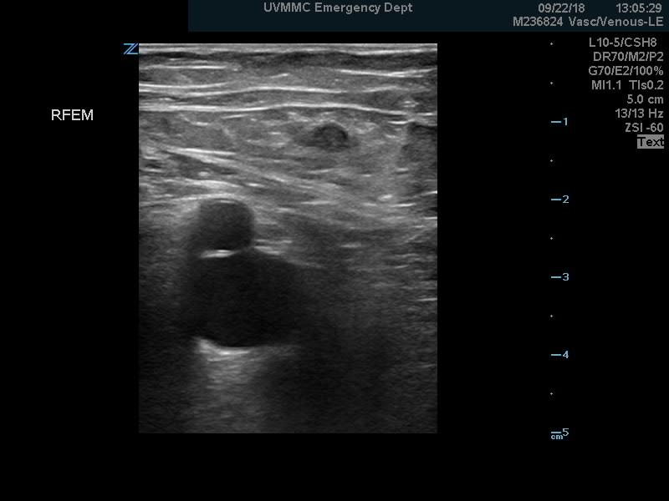
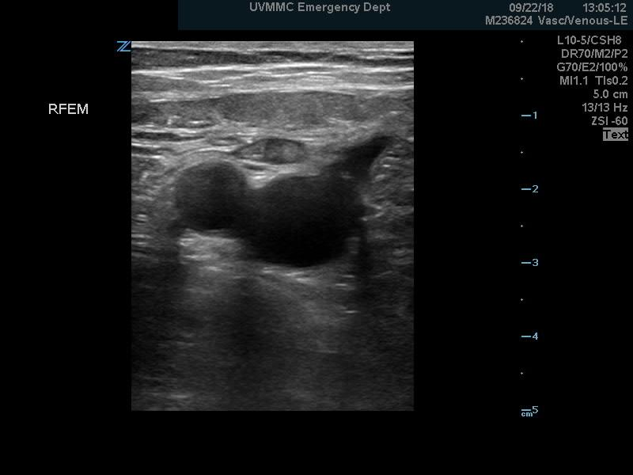
Normal Anatomy
GSV
FV
CFA
FA
PV
V
V
CFV
FV
FV
FV
V
PA
PA
DFV

Slide 20
POCUS Evaluation for DVT

Slide 21
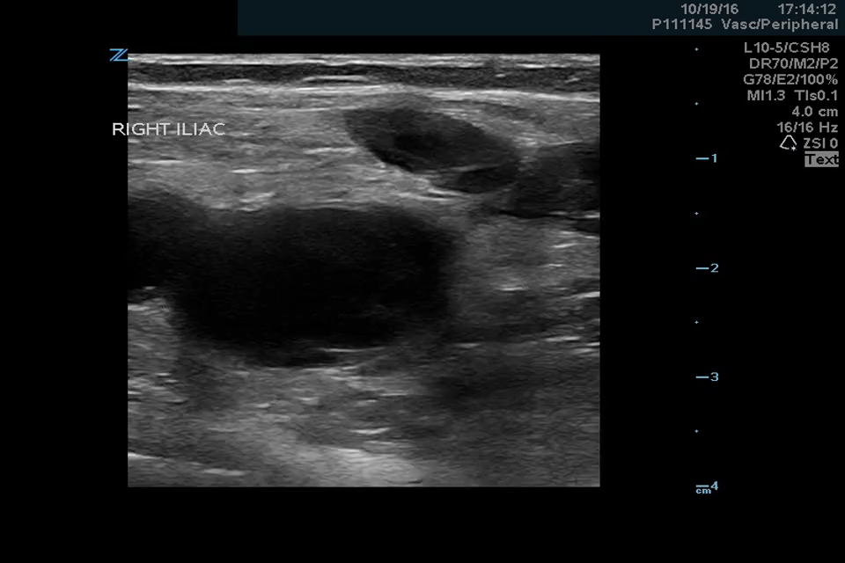
Pathology - DVT

Slide 22
DVT POCUS- Clinical Decision Making
DVT POCUS
TX
+
-
PP
LOW
HIGH
MOD
N/A
D-Dimer
COMP
+/- COMP

Slide 23
DVT POCUS- Cases

